Slide 1


DEPARTMENT OF RHEUMATOLOGY AND CLINICAL IMMUNOLOGY
Η διατροφή στην αυτοανοσία:
δεδομένα από το εργαστήριο με εφαρμογή στην κλινική πράξη
Δημήτριος Π. Μπόγδανος, MBA, MD, PhD
www.autorheumatology.com
Καθηγητής Παθολογίας και Αυτοάνοσων Νοσημάτων,
Ιατρική Σχολή Πανεπιστημίου Θεσσαλίας
Διευθυντής, Κλινική Ρευματολογίας και κλινικής Ανοσολογίας
Πανεπιστημιακό Γενικό Νοσοκομείο Λάρισας

Slide 2
DEPARTMENT OF RHEUMATOLOGY AND CLINICAL IMMUNOLOGY
Disclosure statement
My Travel and Accommodation expenses are covered by ΚΟΠΕΡ
I did not receive a lecture honorarium for this lecture
I am the co-founder of Biolympus spin-off (CERTH, Hellas)
I do not have financial or any other professional relationship with a commercial organization that could influence the content of my presentation

Slide 3
I have received received honoraria, diagnostic reagents for free /
or participated in collaborative projects
Bega
Biolympus
Biorad
CyBio
Diarect
Euclone
Euroimmun
Generic Assays
Genesis
Gilead
InnoVision
Invitrogen
Inova
Koper
MabTech
Mardx
MBL
Meridian LS
Menarini Diagnostics
Menarini Pharma
Miltenyi
Molecular Probes
Novartis
PeproTech
Pharmacia
Roche
Virusys

Slide 4
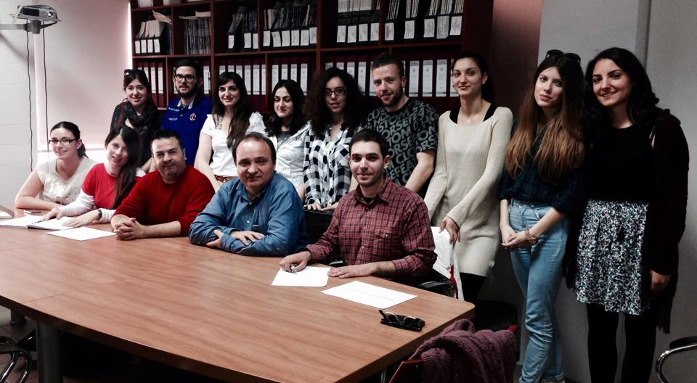
CIMI Laboratory group (Bogdanos lab)

Slide 5





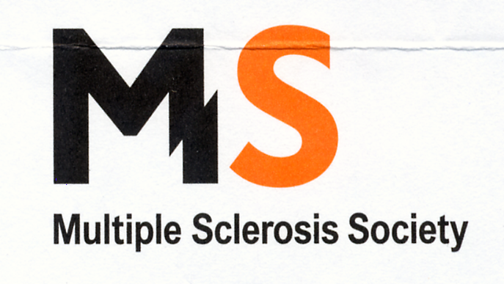
Grant Giving Bodies

Slide 6
Prof Noel Rose
The father of autoimmunity
(1922-2020)

Slide 7
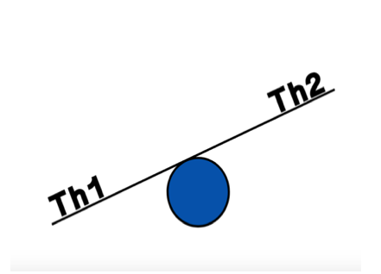
Βασικές Aρχές Aνοσολογίας – Υγιές Ανοσοποιητικό
Iσορροπία μεταξύ της Τh1/Τh2 Aνοσιακής Aπόκρισης
IL4
IFNγ
Parish J Clin Invest 1971

Slide 8
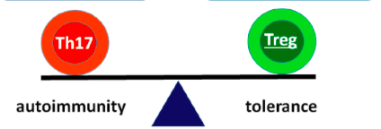
Th17 –Treg ισορροπία
IL17
IL10

Slide 9
Βασικές αρχές αυτοανοσίας –Ρευματοειδής Αρθρίτιδα
Antigen Presenting Cells
Antigen presentation
Costimulatory molecules
Cytokine production
TNF-α
IL-4
B cells
Th1 cells
Th-2 cells
IFN-γ
IL-10
ACPA- anti-CCP
© Copyright DP Bogdanos 2019

Slide 10
Fine Balance of Pro-inflammatory and Anti-Inflammatory Immune Cells
Th17
IL-17
IL-22
Tregs
IL-10
Macrophages
Activation
Cytokine production
NO production
APC
Antigen presentation
Costimulatory molecules
Cytokine production
Phogocytosis
IL-10
Bregs
B cells
Th1
Th17
Th2
Th cells
© Copyright DP Bogdanos 2016
IFN-γ
autoabs

Slide 11
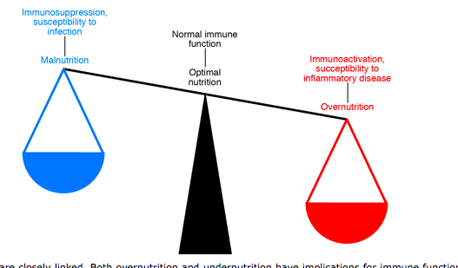
Normal immune system: a thin line between malnutrition and over-nutrition
KE Wellen J Clin Invest 2005

Slide 12
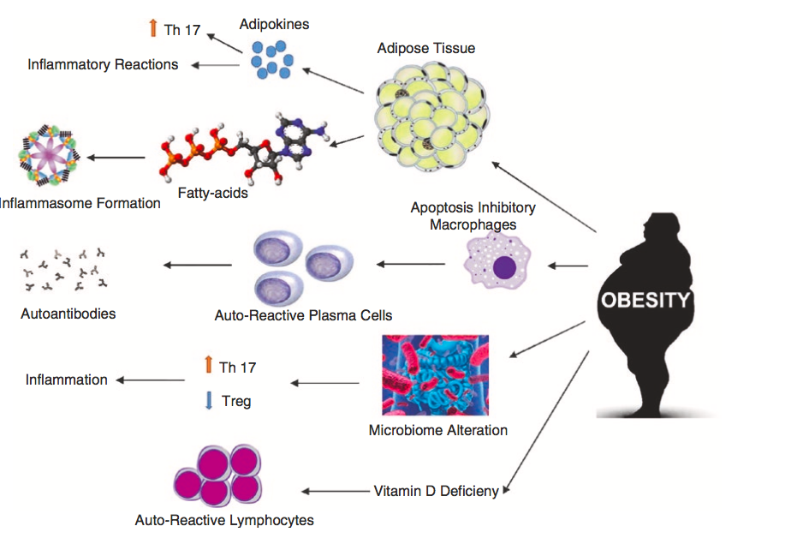
Παχυσαρκία και Ανοσοφλεγμονή

Slide 13
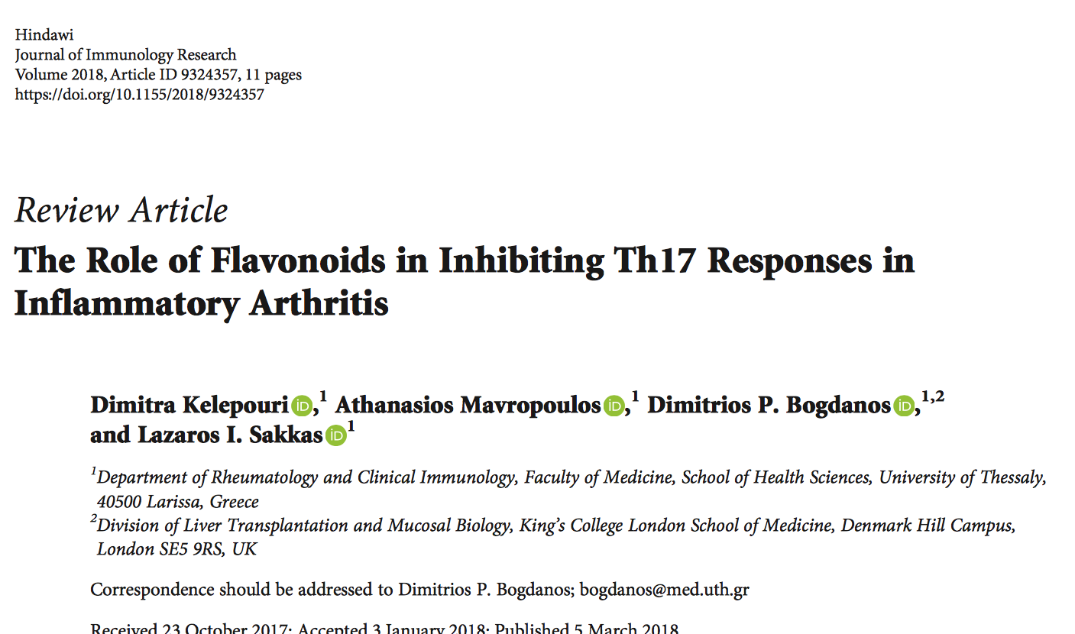

Slide 14
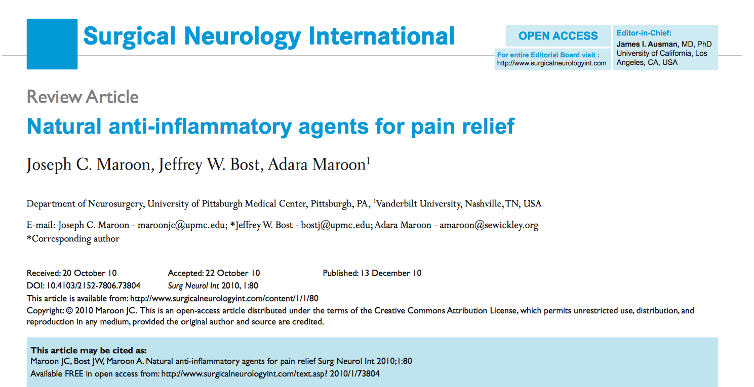
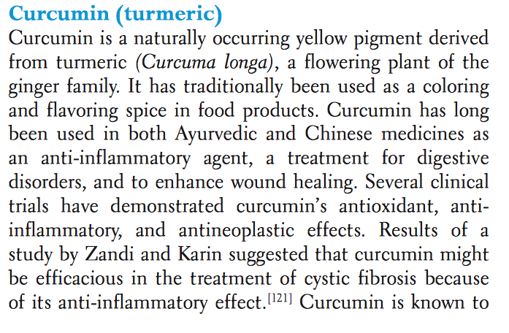

Slide 15
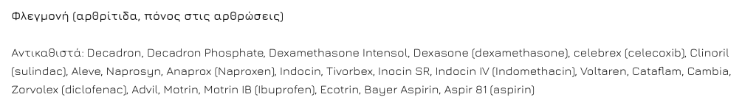
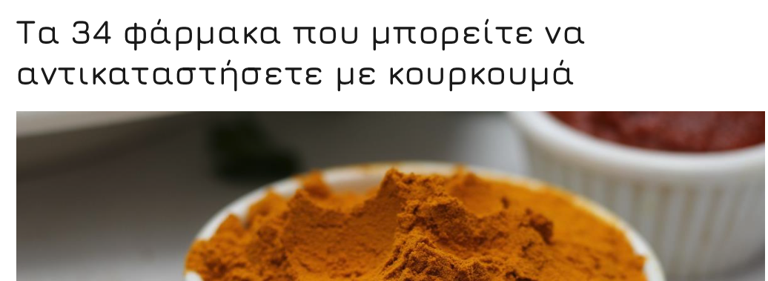
Κανένα φάρμακο ΔΕΝ μπορεί να αντικατασταθεί με κουρκουμά,
ακόμη και σε φαρμακευτικές δόσεις

Slide 16


Slide 17
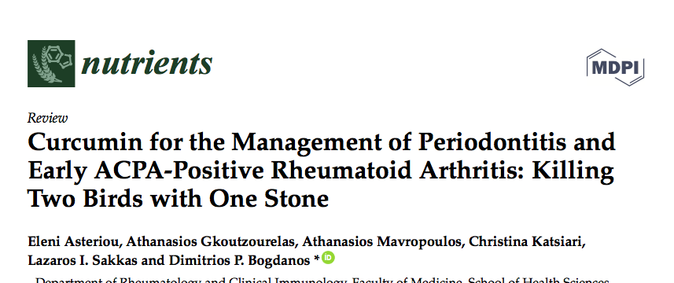
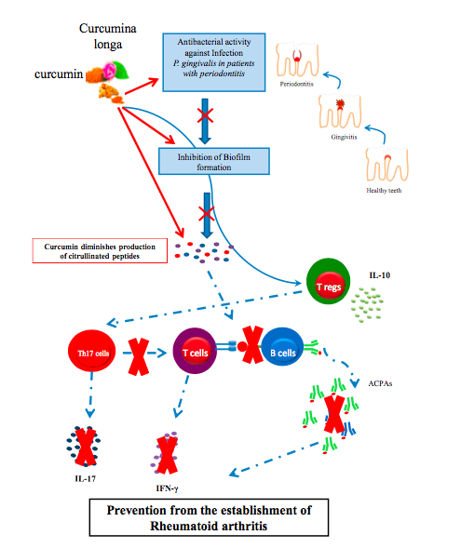
Curcumin and autoimmunity

Slide 18
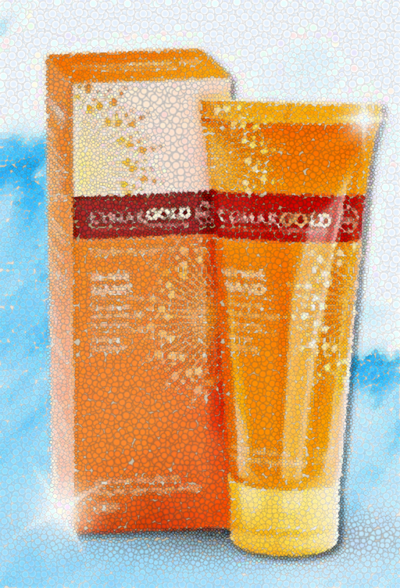
Gel – Αλοιφή κουρκουμίνης για επάλειψη σε ασθενείς με ψωρίαση

Slide 19
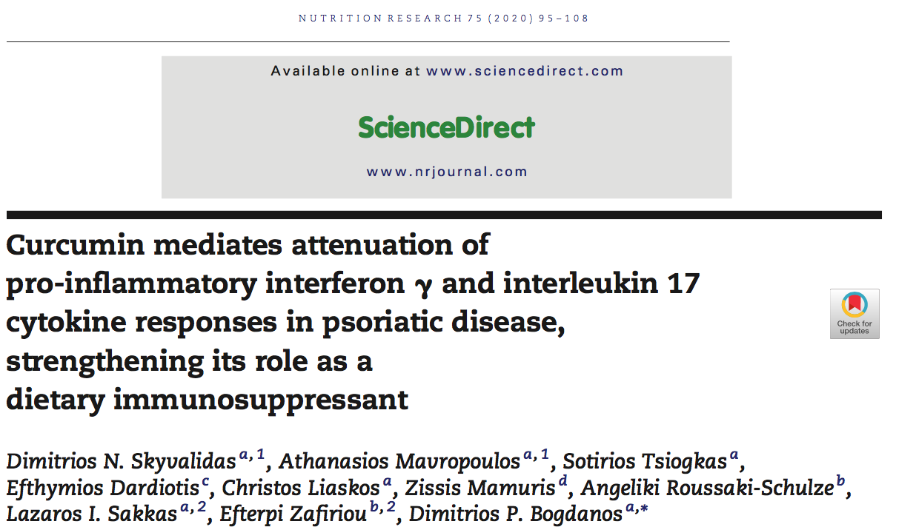
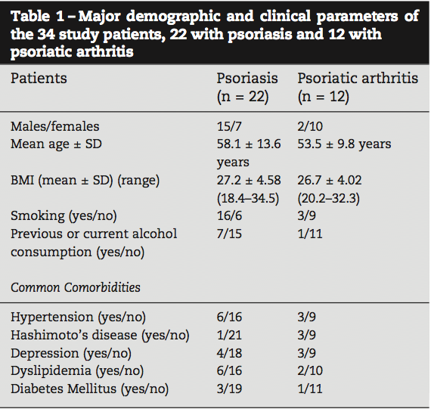

Slide 20
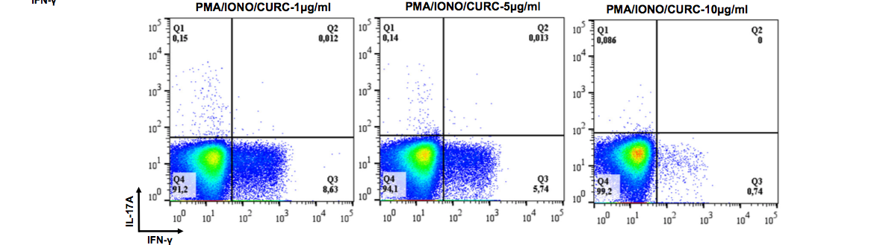
Επίδραση της Κουρκουμίνης στα κύτταρα που παράγουν IFNγ και IL-17

Slide 21
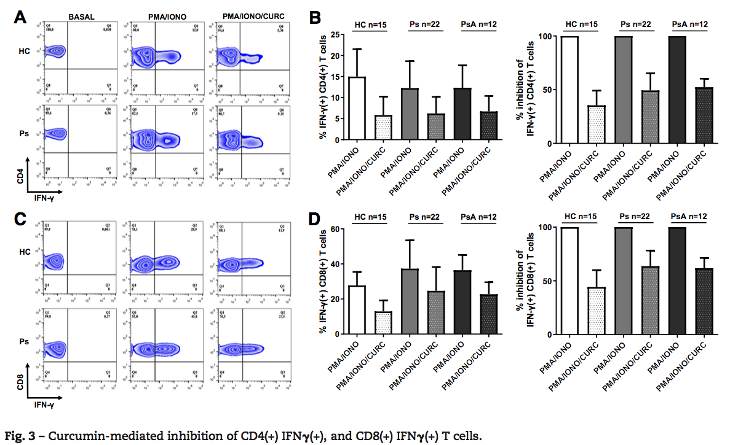
In vitro επίδραση της Κουρκουμίνης
σε ασθενείς με ψωρίαση ή ψωριασική αρθρίτιδα

Slide 22
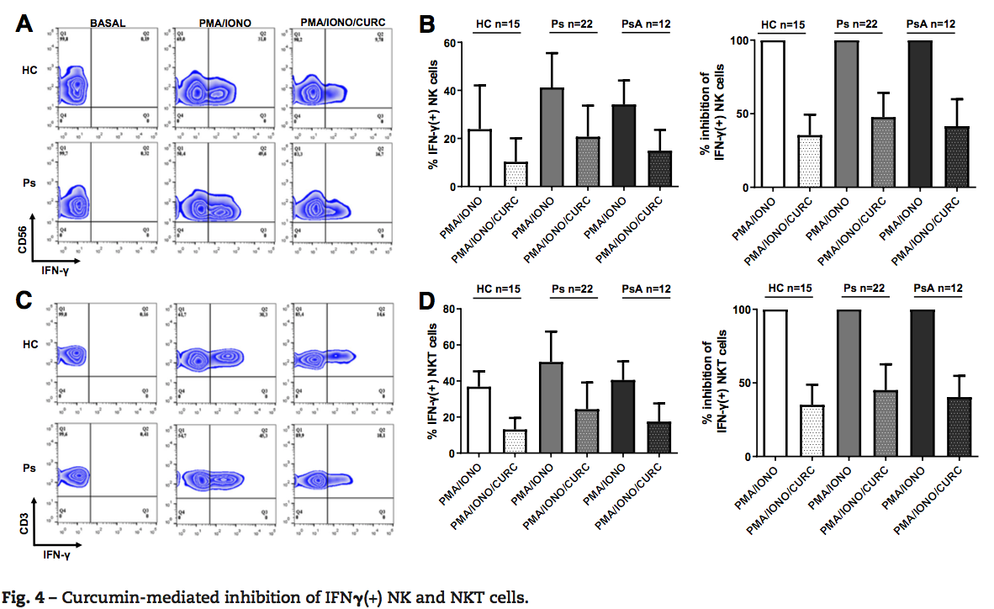
In vitro επίδραση της Κουρκουμίνης
σε ασθενείς με ψωρίαση ή ψωριασική αρθρίτιδα

Slide 23
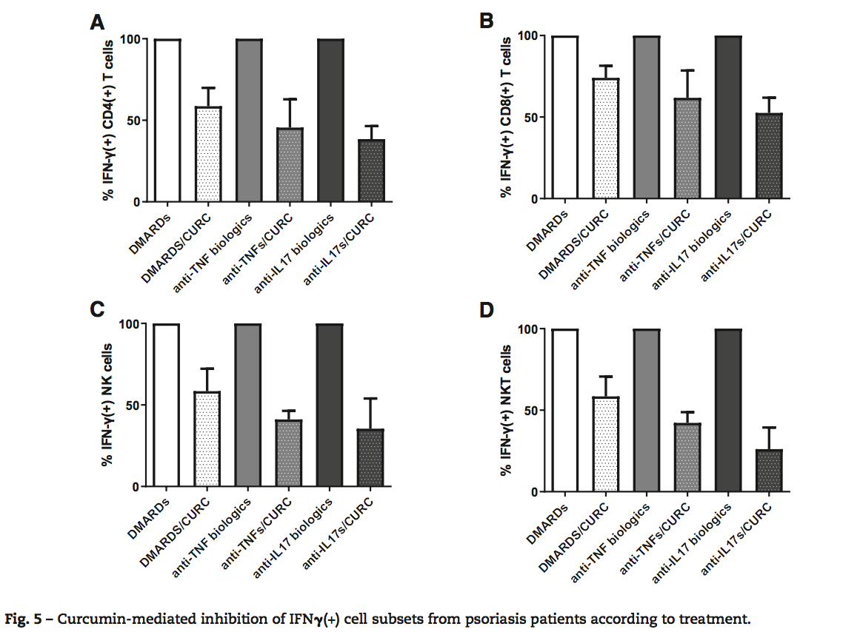

Slide 24
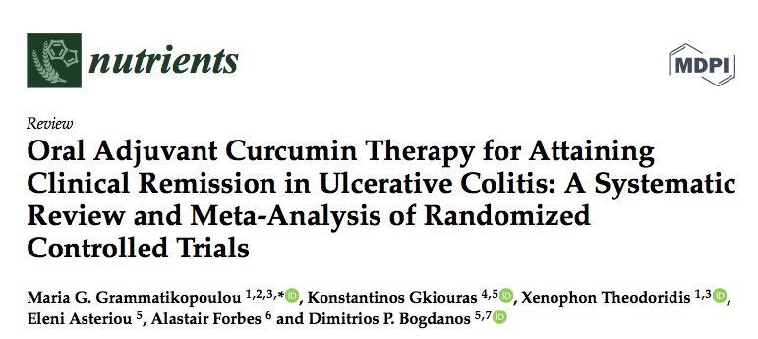
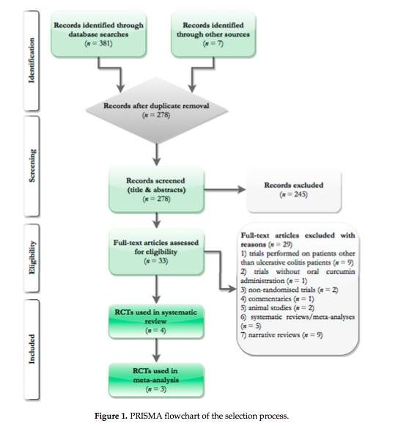
Curcumin and autoimmunity
Based on the current available
evidence, oral curcumin administration
does not seem superior to placebo
in attaining remission in
patients with UC

Slide 25
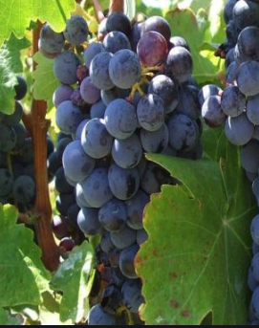
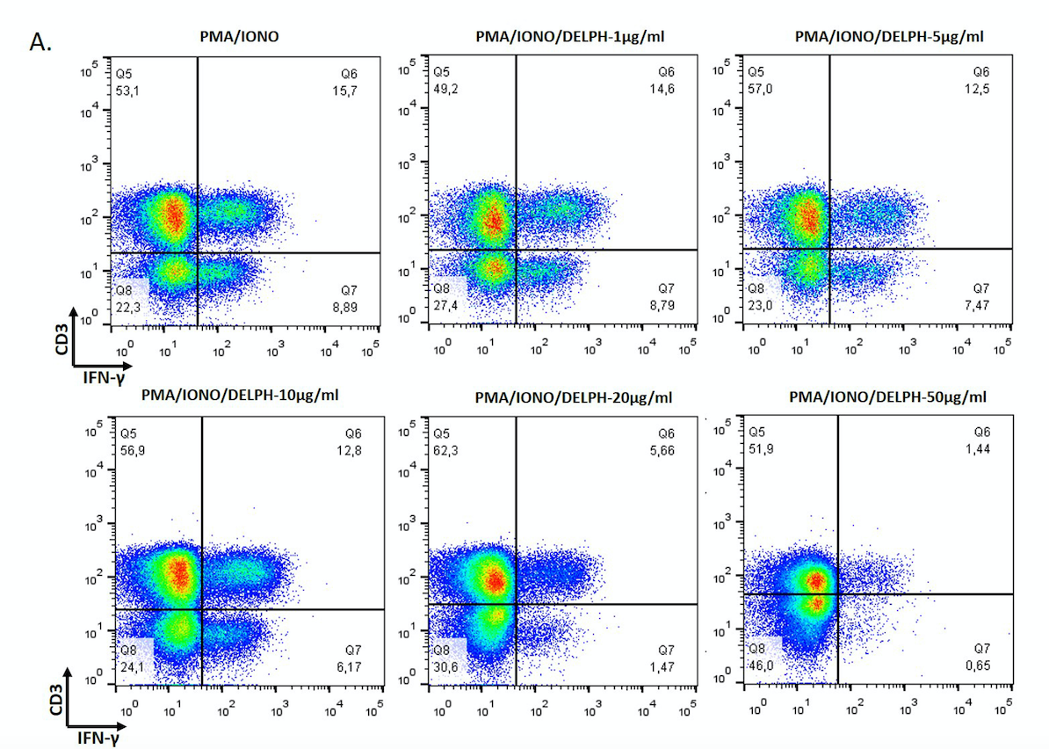
In vitro επίδραση της Δελφινιδίνης
σε ασθενείς με ψωρίαση ή ψωριασική αρθρίτιδα

Slide 26
Σκοπός της μελέτης
Μελέτη Παν. Θεσσαλίας (Δ. Π. Μπόγδανος & Δ. Αθανάτου)
Μελέτη διαιτητικών συνηθειών και διατροφικών αλλαγών σε ασθενείς με Ρευματικά και άλλα Αυτοάνοσα νοσήματα
Εάν η χρήση κανναβιδέλαιου CBD ή κουρκουμίνης, επιδρά συνεργικά με τη μεσογειακή διατροφή στον πόνο των ασθενών με ρευματικά και άλλα αυτοάνοσα νοσήματα
Βελτιώνει τους δείκτες της φλεγμονής, την ποιότητα του ύπνου και την ποιότητα ζωής

Slide 27

Έναρξη: 77 ασθενείς (67 Γυναίκες- 10 Άντρες)
Λήξη: 22 ασθενείς (20 Γυναίκες- 2 Άντρες)

Slide 28
Ηλικία ασθενών

Slide 29
Σωματικό βάρος αντρών

Slide 30
Σωματικό βάρος γυναικών

Slide 31
Μέση Περίμετρος Αντρών

Slide 32
Μέση Περίμετρος Γυναικών

Slide 33
Σπλαχνικό λίπος

Slide 34
Λιπώδης μάζα

Slide 35
CBD/curcumin 1g & πόνος

Slide 36
CBD/curcumin 1g & βελτίωση πόνου

Slide 37
CBD/curcumin 1g & κατάθλιψη

Slide 38
CBD/curcumin 1g & ποιότητα ύπνου

Slide 39
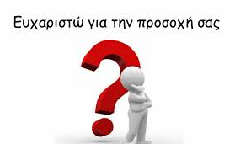

Slide 40
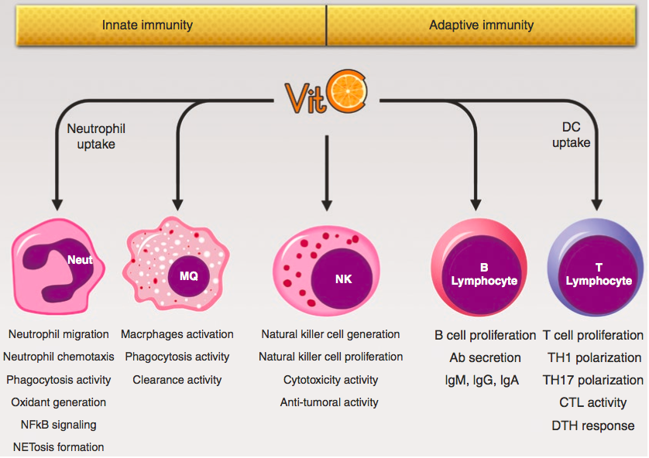
Vitamin C and immune system

Slide 41
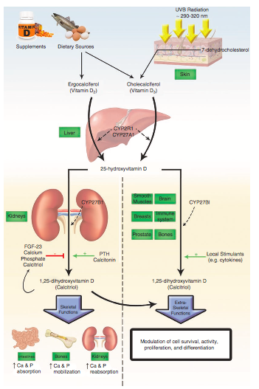
Vitamin D and immunity

Slide 42
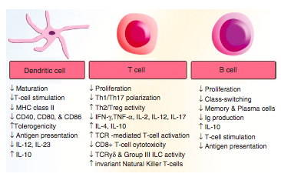
Vitamin D and immunity

Slide 43
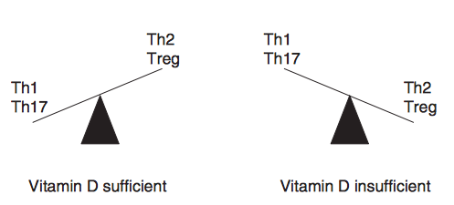
Vitamin D and immunity

Slide 44
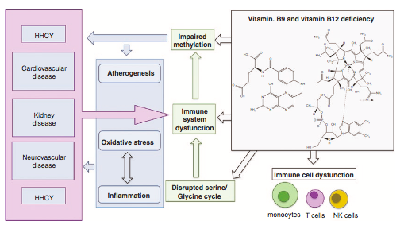
Vitamin B12 and immunity

Slide 45
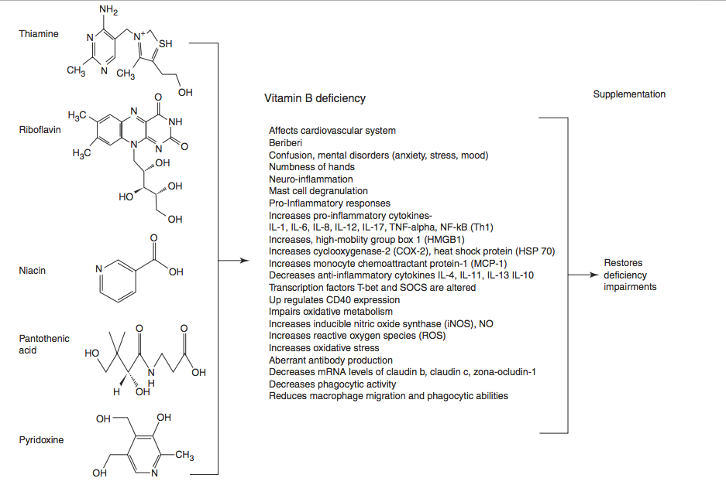
Vitamin B1, B2, B3, B5, and B6 and the Immune System
Notes:
The causes of autism spectrum disorder (ASD) are complex and not entirely clear. Alterations in the mother's immune system during pregnancy, especially during key early periods of fetal neurodevelopment, may play a role. Choi et al. provided infectious or inflammatory stimuli to pregnant mice, which resulted in of spring exhibiting behaviors reminiscent of ASD (see the Perspective by Estes and McAllister). A subset of T helper cells that make the cytokine interleukin-17a in the mothers caused cortical defects and associated ASD behaviors in offspring. Therapeutic targeting of interleukin-17a during gestation reduced ASD symptoms in offspring.

Slide 46
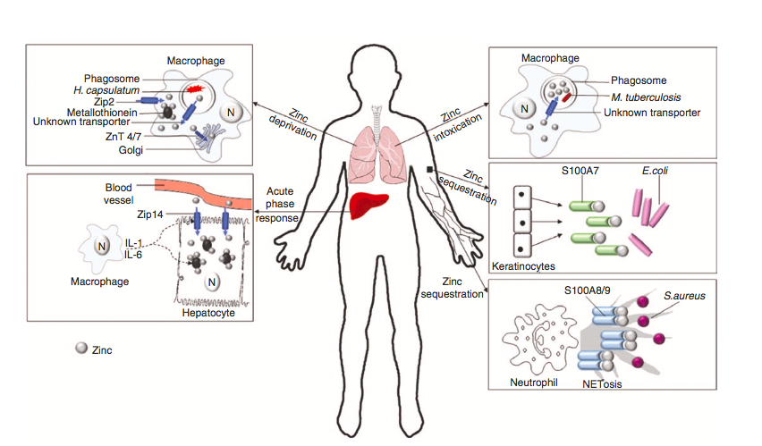
Zinc and Immune system
Notes:
Zinc de ciency causes adverse effects on the immune system such as autoim- mune disorders, allergies, increased sus- ceptibility to infections, thymic atrophy, and cancers.

Slide 47
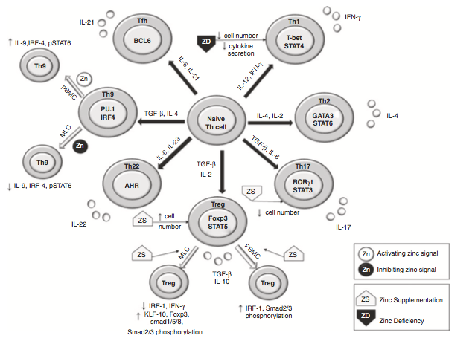
Zinc and Immune system
Notes:
Zinc de ciency causes adverse effects on the immune system such as autoim- mune disorders, allergies, increased sus- ceptibility to infections, thymic atrophy, and cancers.

Slide 48
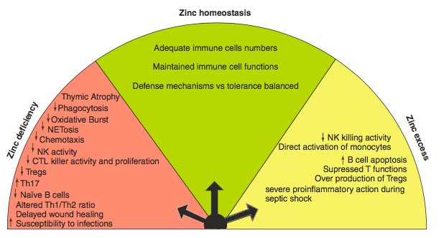
Zinc and Immune system
Notes:
Zinc de ciency causes adverse effects on the immune system such as autoim- mune disorders, allergies, increased sus- ceptibility to infections, thymic atrophy, and cancers.

Slide 49
Selenium and Immune system
Se intake through Se-rich food such as Brazil nuts,
sun ower seeds, lean pork, seafood etc. is ideal.
Supplementation of Se can prevent the development of both
bacterial (Mycobacterium tuberculosis) and viral infections.
Excess Se supplementation could result in decreased
immunity and increased oxidative stress.
Notes:
Zinc de ciency causes adverse effects on the immune system such as autoim- mune disorders, allergies, increased sus- ceptibility to infections, thymic atrophy, and cancers.

Slide 50
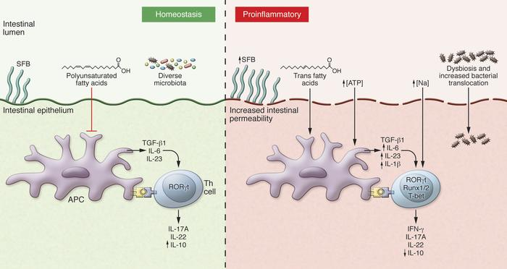
Th17, microbiome environment and inflammation
Burcett J Clin Invest 2015

Slide 51
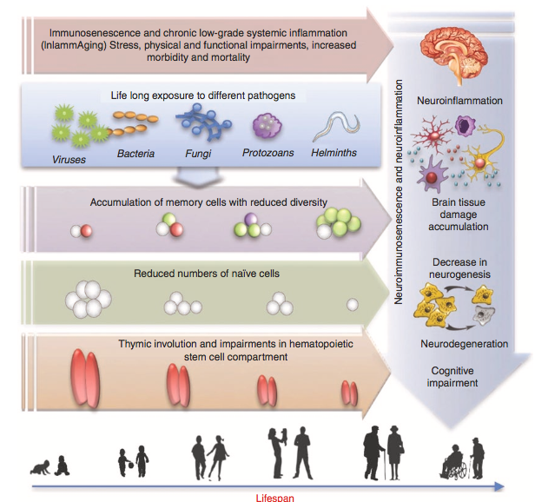
Age and Immune System

Slide 52
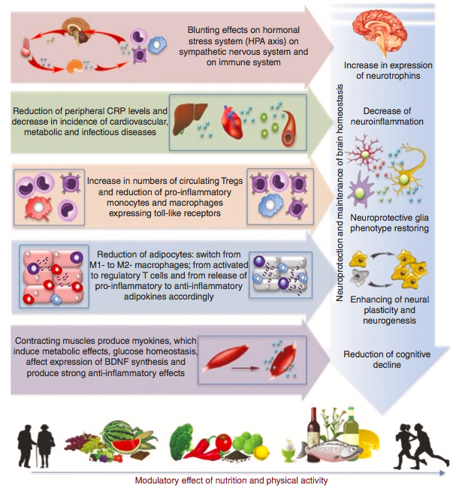
Age, Nutrition, Immune System and Neuroinflammation

Slide 53
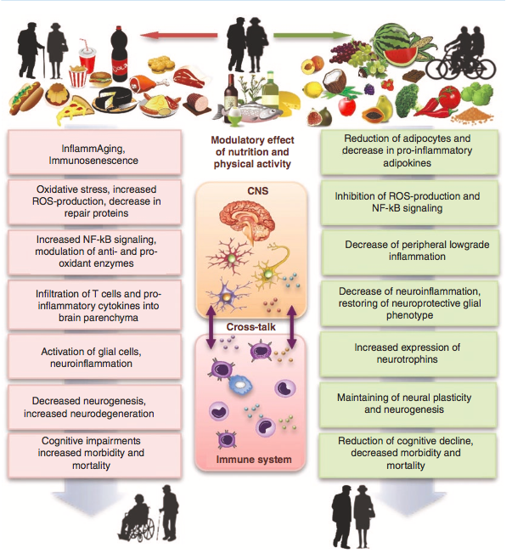
Age, Nutrition, Immune System and Neuroinflammation

Slide 54
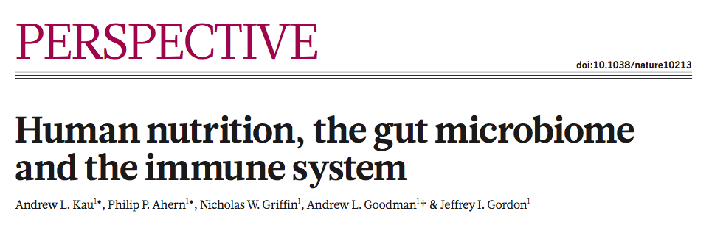
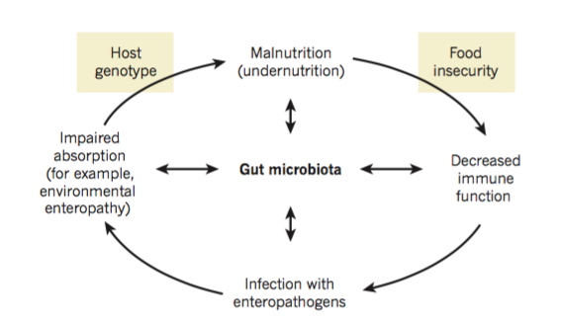
Gut microbiota and Immune Response
Notes:
A schematic of the proposed relationships between the
gut microbiota, the immune system and the diet, which underlie the developmentofmalnutrition. Undernutritionisassociatedwithseveral defects in the innate and adaptive immune systems, which, in turn, are associated with increased predisposition to diarrhoeal illnesses. Recurrent (enteric) infections predispose to macronutrient and micronutrient deficiencies, as well as impaired intestinal mucosal barrier function77. These factors lead to
a cycle of further susceptibility to infection and worsening nutritional status. A confounding problem is that vaccines designed to protect children from certain pathogens (including enteropathogens) show poor efficacy in areas of the world where poor nutrition is rampant74. One testable hypothesis is that the microbiota contributes to disease risk and pathogenesis. Diet shapes gut microbial community structure and function, and the microbiota adapts in ways that promote nutrient processing; the ability of the microbiota to process a given diet affects the nutrient and energetic value of that diet. The microbiota and immune systems co-evolve: malnutrition affects the innate and adaptive immune systems as well as the microbiota. The microbiota acts as a barrier to enteropathogen infection; this barrier function may be disrupted by malnutrition, as well as
by perturbations in immune system function. The microbiota affects nutrient processing by the host, including the expression of host genes involved in nutrient transport and metabolism.

Slide 55
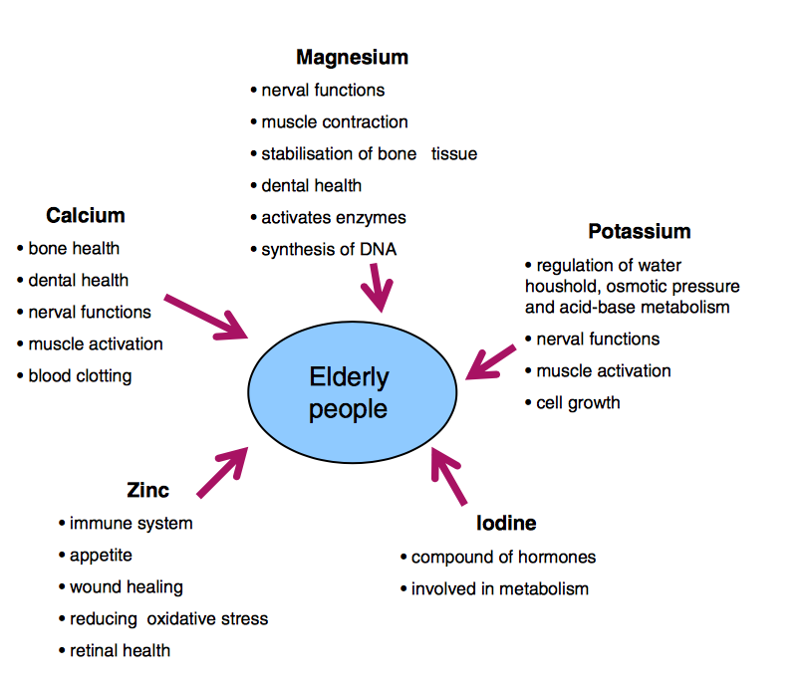
Electrolytes: Functions, regulation

Slide 56
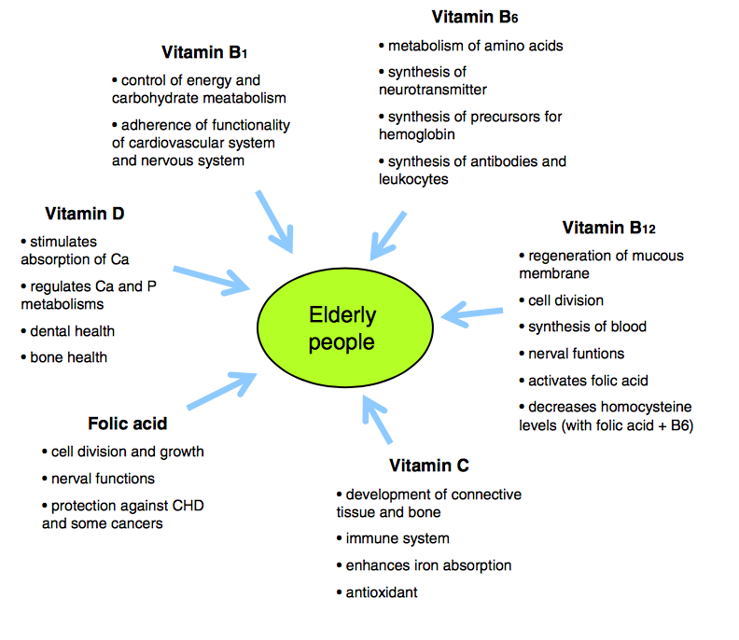

Slide 57
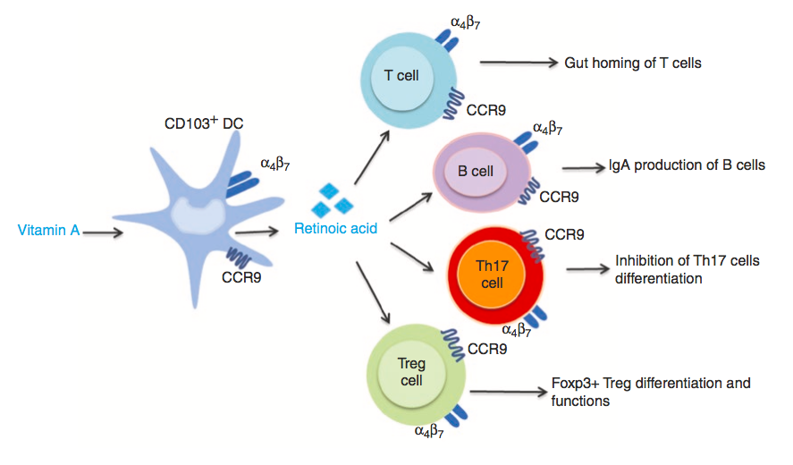
Vitamin A and the Immune system

Slide 58
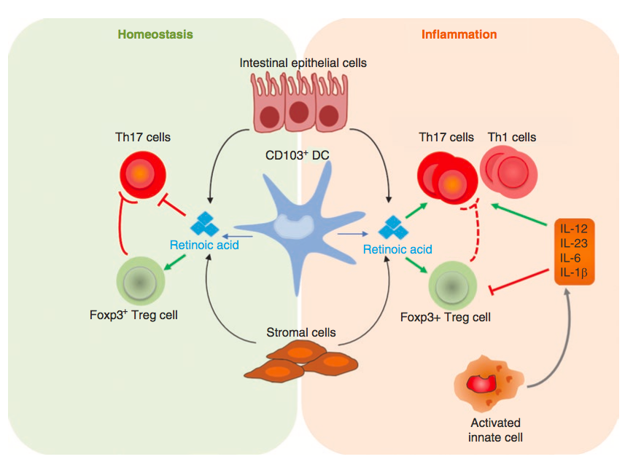
Retinoid Acid and the Immune system

